Slide 1
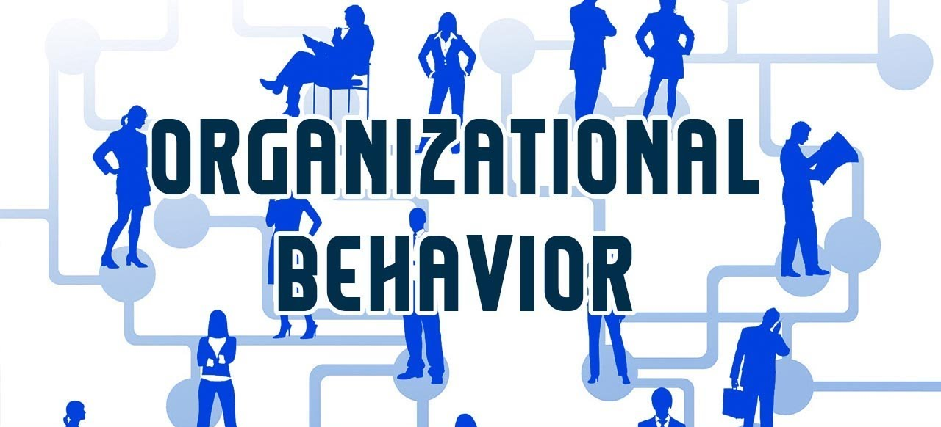


Organizational Behavior
Reading: Chapter 1 (Organizational Behavior by Stephen P. Robbins, 15th ed.)
Instructor: Dr. Muhammad Rafiq

Slide 2
Books to follow
Title of Book |  | Organizational Behavior | Edition
 |  |  | 15th
Author |  | Stephen P. Robbins, Timothy A. Judge, Neharika Vohra
Publisher |  | Pearson – Prentice Hall
1. | Title of Book | Organizational Behavior: An evidence based approach
 | Imprint details | By: Fred Luthans (12th edition - 2013) – McGraw-Hill
2. | Title of Book | Principles of Organizational Behavior (3rd edition - 2012)
 | Imprint details | By: R. Fincham, P. Rhodes; Oxford University Press
3. | Title of Book | Essentials of Organizational Behavior (13th edition - 2017)
 | Imprint details | By: Stephen P. Robbins, Timothy A. Judge; Pearson

Slide 3
Course Objectives
To enable students to understand the importance of OB theory and concepts.
To develop a deeper understanding of how the study of organisational behaviour can aid us in improving the performance and well being of people at work;
To make understand how models, theories and concepts about organisational behaviour can be used to promote the effectiveness of individuals, groups and organizations;
To develop skills for the analysis of individual, group and organisational functioning that enhances their effectiveness as managers;
To develop a richer and more complex representation of organisational behavior, enabling them to contribute more effectively in the workplace.

Slide 4
Organizational Behavior
Introduction

Slide 5
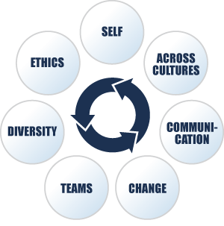
Organizational Behavior (OB)
A field of study that investigates the impact that individuals, groups, and structure have on behavior within organizations, for the purpose of applying such knowledge toward improving an organization’s effectiveness.
Notes:
Organizational Behavior studies the influence that individuals, groups and structure have on behavior within organizations.
Its chief goal is to apply that knowledge toward improving an organization’s effectiveness.

Slide 6
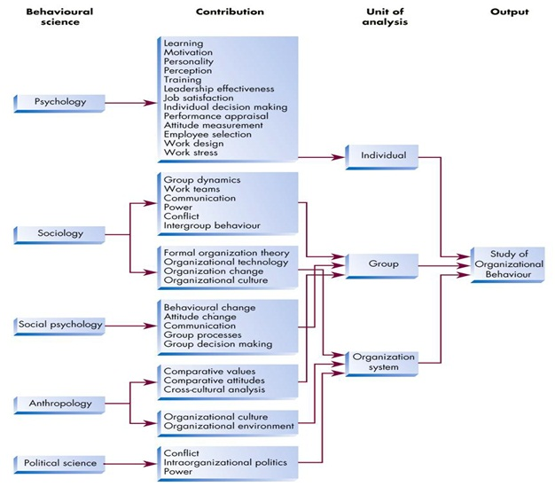
Contributing Disciplines to OB
Psychology The science that seeks to measure, explain, and sometimes change the behavior of humans and other animals.
Sociology The study of people in relation to their fellow human beings.
Social Psychology An area within psychology that blends concepts from psychology and sociology and that focuses on the influence of people on one another.
Anthropology The study of societies to learn about human beings and their activities.

Slide 7
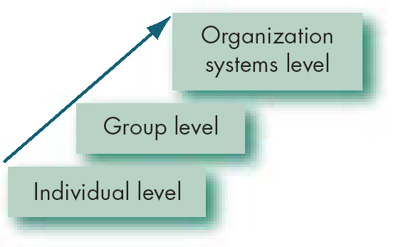
Three Levels of OB Analysis
Organizational Level
•
Productivity
•
Developing effective employees
•
Global competition
•
Managing in the global village
Group Level
•
Working with others
Workplace
•
Workforce diversity
Individual Level
•
Job satisfaction
•
Empowerment
•
Behaving ethically

Slide 8
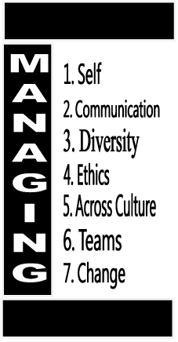
Why Do We Study OB?
To learn about yourself and others.
To understand how the many organizations you encounter work.
To become familiar with team work.
To help you think about the people issues faced by managers and entrepreneurs

Slide 9

What Managers Do?
Managers (or administrators)
Individuals who achieve goals through other people.
Managerial Activities
Make decisions
Allocate resources
Direct activities of others to attain goals

Slide 10

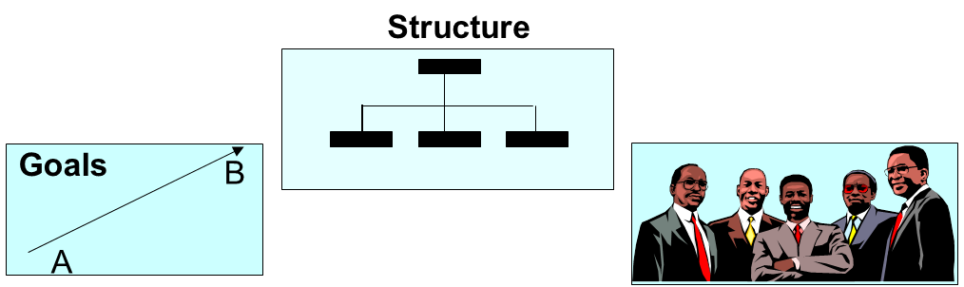
Where Managers Work
Organization
A consciously coordinated social unit, composed of two or more people, that functions on a relatively continuous basis to achieve a common goal or set of goals.

Slide 11

Management?
Management is the attainment of organizational goals in an effective and efficient manner through planning, organizing, leading, and controlling organizational resources:
Managers get things done through the organization.
Managers create right systems and environment.
Organizations need good managers.
Coordination of the work activities of others so that their
activities are completed efficiently and effectively.

Slide 12
Management Functions (cont’d)
Planning
A process that includes defining goals, establishing strategy, and developing plans to coordinate activities.
Organizing
Determining what tasks are to be done, who is to do them, how the tasks are to be grouped, who reports to whom, and where decisions are to be made.
Leading
A function that includes motivating employees, directing others, selecting the most effective communication channels, and resolving conflicts.
Controlling
Monitoring activities to ensure they are being accomplished as planned and correcting any significant deviations.

Slide 13
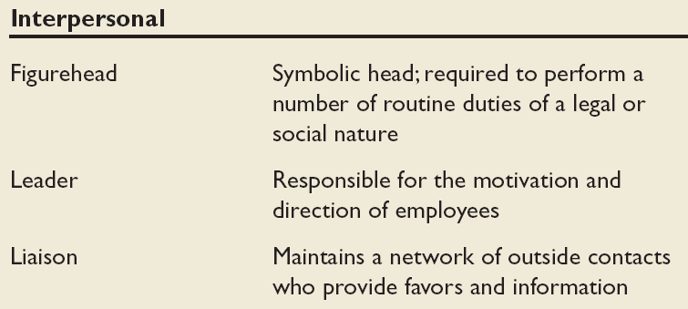
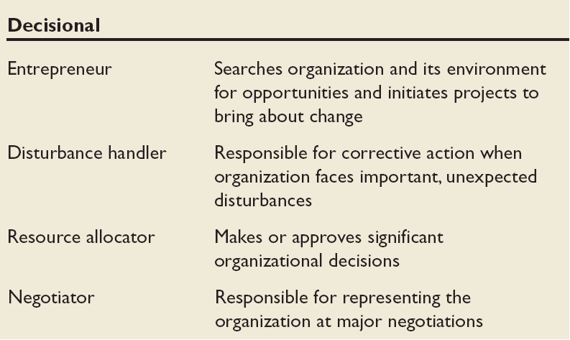
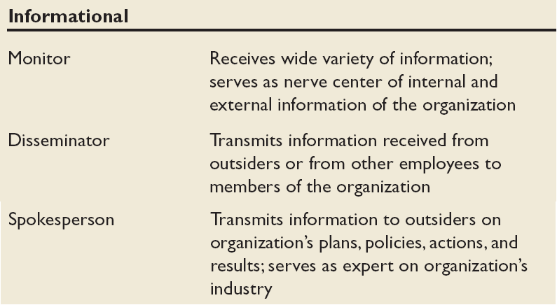
Mintzberg’s Managerial Roles
Source: Adapted from The Nature of Managerial Work by H. Mintzberg. Copyright © 1973 by H. Mintzberg. Reprinted by permission of Pearson Education.

Slide 14
Management Skills
Technical skills The ability to apply specialized knowledge or expertise.
Human skills The ability to work with, understand, and motivate other people, both individually and in groups.
Conceptual Skills The mental ability to analyze and diagnose complex situations.

Slide 15
There Are Few Absolutes in OB
Impossible to make simple and accurate generalizations.
Human beings are complex and diverse.
OB concepts must reflect situational conditions: contingency variables
Situational factors that make the main relationship between two variables change ---e.g., the relationship may hold for one condition but not another.
In Country 1: x
May be related to
y
In Country 2: x
y
May NOT be related to
Notes:
Contingency Theory: The contingency theory focuses on specific situational factors that can affect the direct relationships between independent and dependent variables. The theory explains that there is not an exact science to organizational behavior.

Slide 16
Challenges and Opportunities for OB
The workplace contains a wide mix of cultures, races, ethnic groups, genders and ages
Employees have to learn to cope with rapid change due to global competition
Corporate loyalty has decreased due to corporate downsizing and use of temp workers
Managers can benefit from OB theory and concepts

Slide 17


Responding to Globalization
Increased foreign assignments
Differing needs and aspirations in workforce
Working with people from different cultures
Domestic motivational techniques and managerial styles may not work
Overseeing movement of jobs to countries with low-cost labor

Slide 18


Managing Workforce Diversity
Workforce Diversity:
Organizations are becoming a more heterogeneous mix of people in terms of gender, age, race, ethnicity, and sexual orientation.
Embracing diversity
Changing U.S. and world demographics
Implications for managers.
Recognizing and responding to differences
Gender
Race
Age
Religion
Notes:
“Managers have to shift their philosophy from treating everyone alike to recognizing differences and responding to those differences in ways that ensure employee retention and greater productivity while, at the same time, not discriminating.”

Slide 19

OB support in Dealing With
OB not only helps employees understand themselves better, it also offers a roadmap for managers to improve all aspects of their organizations:
Stimulating Innovation and Change
Helping employees balance work-life conflicts
Improving People Skills & performance
Empowering People
Encouraging Leadership
Working in Networked Organizations
Improving Ethical Behavior
Improved customer services
Managing People during the War on Terrorism

Slide 20

Focal Points of OB
Jobs
Work
Absenteeism
Employment turnover
Productivity
Human performance
Management

Slide 21

OB Offers Insights Into:
Improving Quality and Productivity
Quality management (QM)
Process reengineering
Responding to the Labor Shortage
Changing work force demographics
Fewer skilled laborers
Early retirements and older workers
Improving Customer Service
Increased expectation of service quality
Customer-responsive cultures

Slide 22
Complementing Intuition with Systematic Study
Intuition:
The “gut feeling”
Common sense
Individual observation
Systematic study improves ability to accurately predict behavior.
Assumes behavior is not random.
Fundamental consistencies underlie behavior.
These can be identified and modified to reflect individual differences.
Notes:
the ability to understand something instinctively, without the need for conscious reasoning.

Slide 23
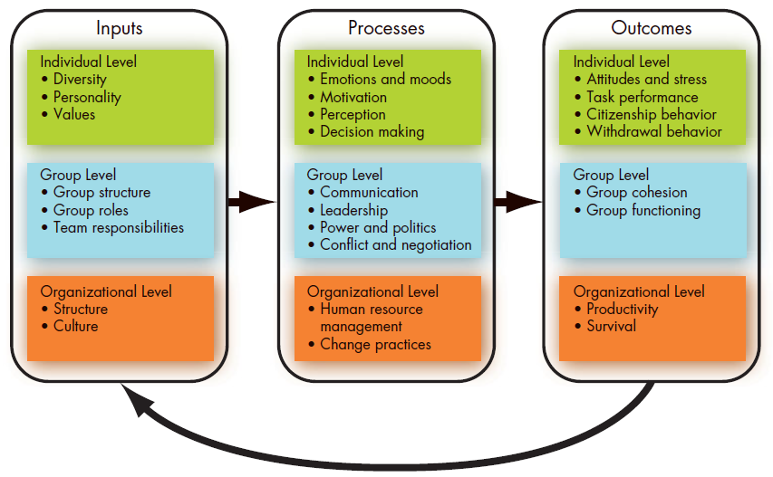
OB Model
Notes:
Input Variables that lead to processes.
Processes Actions that individuals, groups, and organizations engage in as a result of inputs and that lead to certain outcomes.
Outcomes Key factors that are affected by some other variables.

Slide 24

Systematic Study
Examines relationships.
Attempts to attribute causes and effects.
Bases conclusions on scientific evidence:
On data gathered under controlled conditions.
Data is measured and interpreted in a reasonably
rigorous manner.

Slide 25
The Dependent Variables
Dependent variable
A response that is affected by an independent variable (what organizational behavior researchers try to understand).
y
x

Slide 26
The Dependent Variables (cont’d)
Productivity A performance measure that includes effectiveness and efficiency.
Effectiveness Achievement of goals.
Efficiency Meeting goals at a low cost.

Slide 27
The Dependent Variables (cont’d)
Absenteeism
The failure to report to work.
Turnover
The voluntary and involuntary permanent withdrawal from an organization.

Slide 28
The Dependent Variables (cont’d)
Organizational Citizenship Behavior (OCB)
Discretionary behavior that is not part of an employee’s formal job requirements, but that nevertheless promotes the effective functioning of the organization.

Slide 29
The Dependent Variables (cont’d)
Job satisfaction
A general attitude (not a behavior) toward one’s job; a positive feeling of one's job resulting from an evaluation of its characteristics.
Notes:
a person’s attitude affects thoughts while his/her behavior affects actions.

Slide 30
The Independent Variables
Independent variable
The presumed cause of some change in the dependent variable; major determinants of a dependent variable.
Independent Variables Can Be
Individual-Level Variables
Group-Level Variables
Organization System-Level Variables

Slide 31
Keep in Mind…
OB’s goal is to understand and predict human behavior in organizations.
Fundamental consistencies underlie behavior.
It is more important than ever to learn OB concepts.
Both managers and employees must learn to cope with temporariness.

